Slide 1
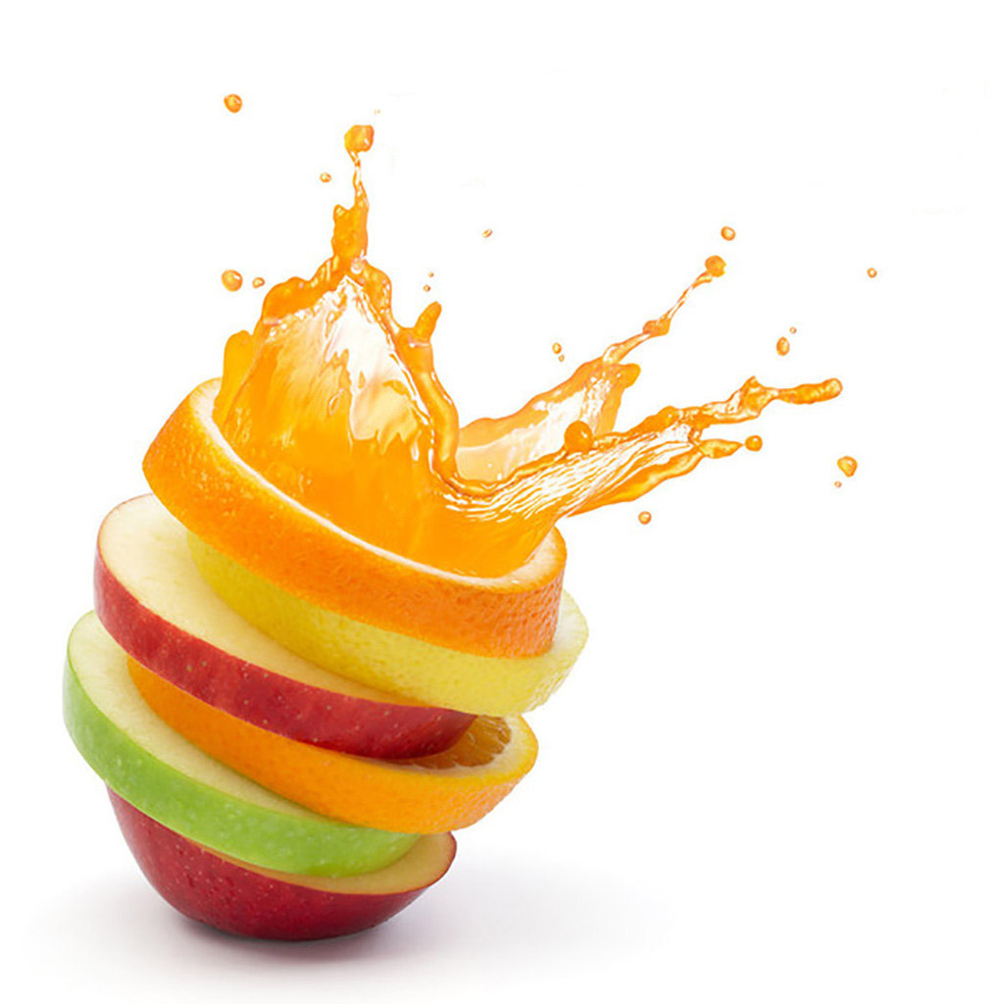
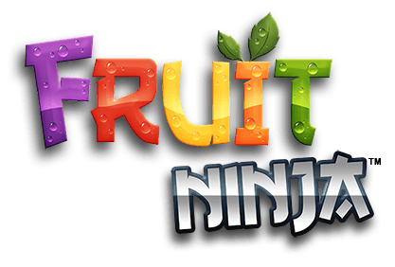
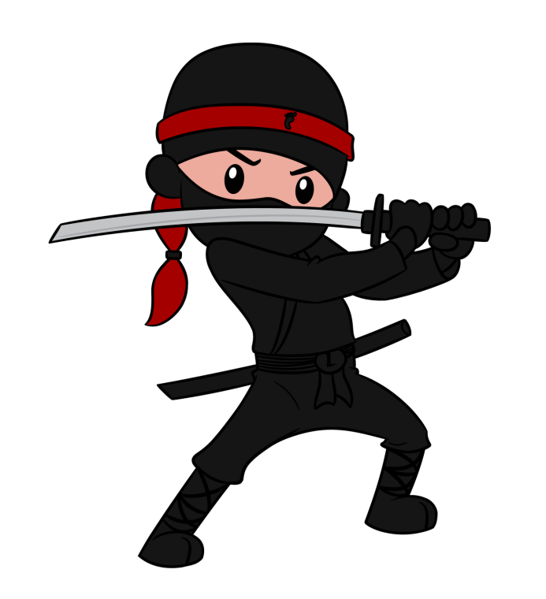

Slide 2
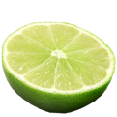


Contributors:
Martin Nikolov (@ flextry)
Stilian Kanchev (@ stiliankanchev)
Daniel Popov (@ damy90)
Stefka Marinova (@ jibonita)
Kiril Todorov (@ kirilt7)
Nevena Angelova (@ nevena-angelova)

Slide 3
Introduction:
The HTML5 Canvas game “Fruit Ninja!” was developed as a team project for the JavaScript IU & DOM course in Telerik Academy.
The following description contains information about the contributors, project description and the URL of GitHub Repository.

Slide 4

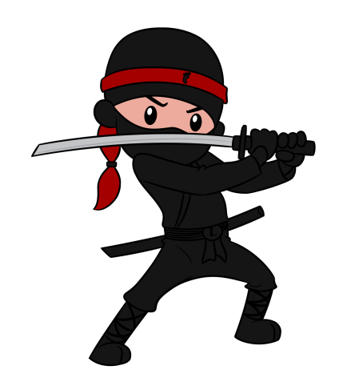
Project Description
“Fruit Ninja” is one of the greatest fruit-slicing game in the world. Fruits are the targets in Fruit Ninja. You must slice them to earn points.
The game is implemented using HTML5, CSS3, HTML5 Canvas + Animations, JavaScript + OOP, Design Patterns, KineticJS, jQuery, RequireJS, etc.

Slide 5
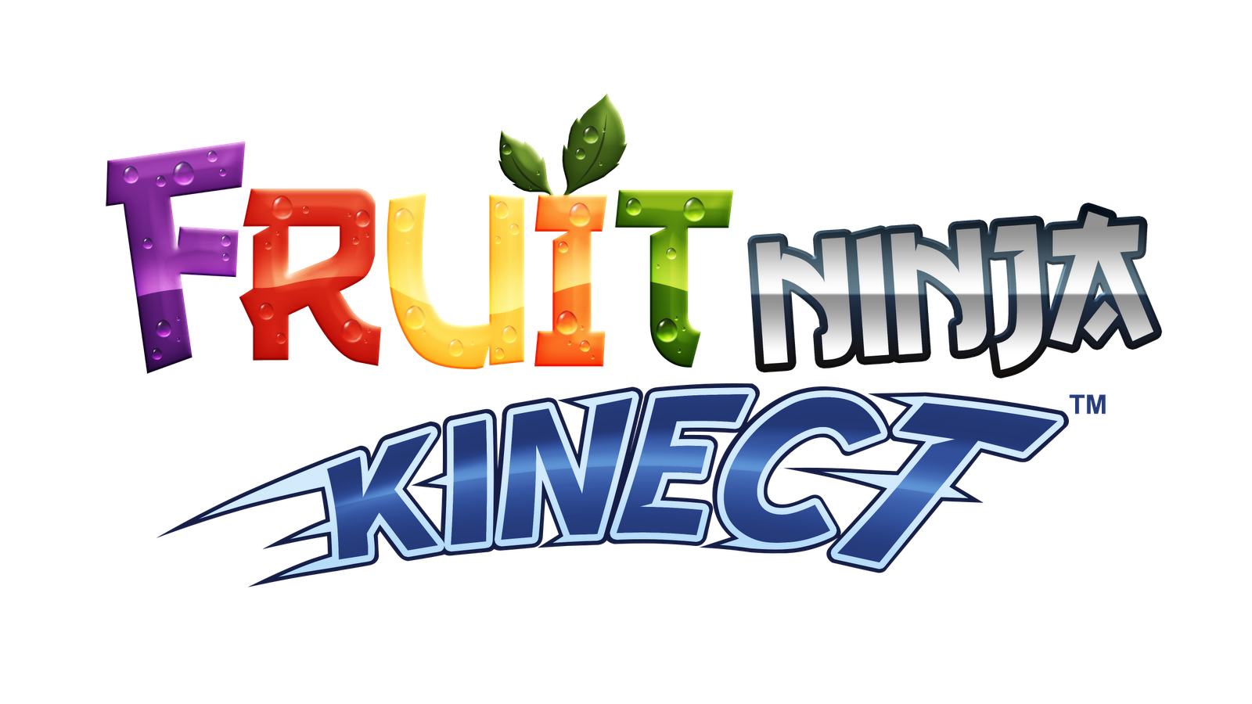
Project Description
We followed the best OOP Practices and SOLID + DRY principles. We put efforts to make the code easy to read, understand and maintain, to ensure correct behavior and to provide simple user interface.

Slide 6
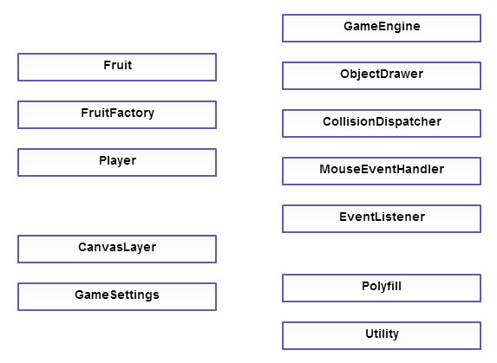
Project UML Diagram

Slide 7

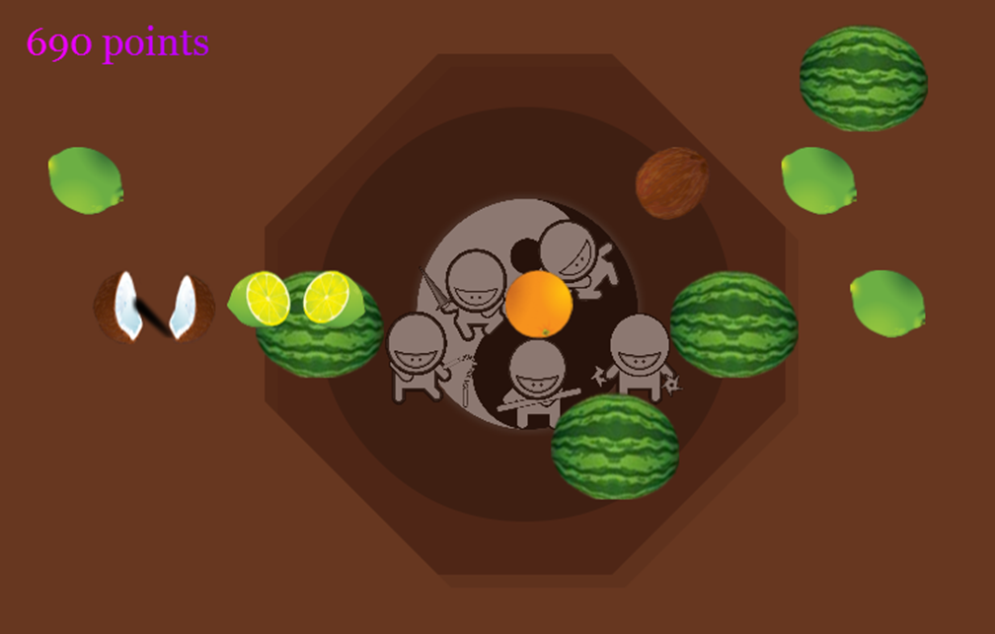

Slide 8



GitHub Repository
You can find the source code at the
following address:
https://github.com/Reiko-JS

Slide 9
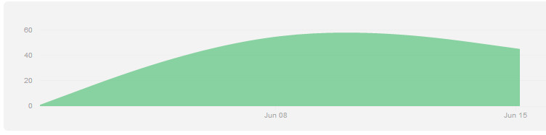
Project Activity
Contributors activity: http://goo.gl/KQO1rf
Commits: http://goo.gl/3wrlYx

